Slide 1

Parallel Programming in C with MPI and OpenMP
Michael J. Quinn

Slide 2
Chapter 11
Matrix Multiplication

Slide 3
Iterative, Row-oriented Algorithm
Series of inner product (dot product) operations
×
=

Slide 4
Block Matrix Multiplication
×
=
Replace scalar multiplication
with matrix multiplication
Replace scalar addition with matrix addition

Slide 5
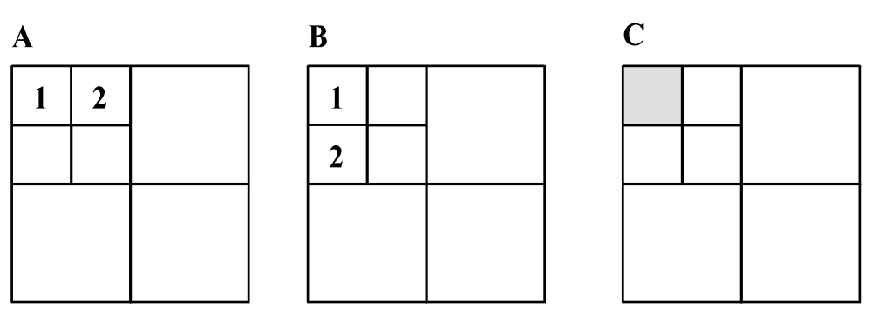
Recurse Until B Small Enough

Slide 6
First Parallel Algorithm
Partitioning
  Divide matrices into rows
  Each primitive task has corresponding rows of three matrices
Communication
  Each task must eventually see every row of B
  Organize tasks into a ring

Slide 7
First Parallel Algorithm (cont.)
Agglomeration and mapping
  Fixed number of tasks, each requiring same amount of computation
  Regular communication among tasks
  Strategy: Assign each process a contiguous group of rows

Slide 8
Communication of B
A
A
A
B
C
A
B
C
A
A
A
B
C
A
B
C

Slide 9
Communication of B
A
A
A
B
C
A
B
C
A
A
A
B
C
A
B
C

Slide 10
Communication of B
A
A
A
B
C
A
B
C
A
A
A
B
C
A
B
C

Slide 11
Communication of B
A
A
A
B
C
A
B
C
A
A
A
B
C
A
B
C

Slide 12
Complexity Analysis
Algorithm has p iterations
During each iteration a process multiplies
(n / p) × (n / p) block of A by (n / p) × n block of B: Θ(n³ / p²)
Total computation time: Θ(n³ / p)
Each process ends up passing
(p-1)n²/p = Θ(n²) elements of B

Slide 13
Weakness of Algorithm 1
Blocks of B being manipulated have p times more columns than rows
Each process must access every element of matrix B
Ratio of computations per communication is poor: only 2n / p

Slide 14
Parallel Algorithm 2
(Cannon’s Algorithm)
Associate a primitive task with each matrix element
Agglomerate tasks responsible for a square (or nearly square) block of C
Computation-to-communication ratio rises to n / √p

Slide 15
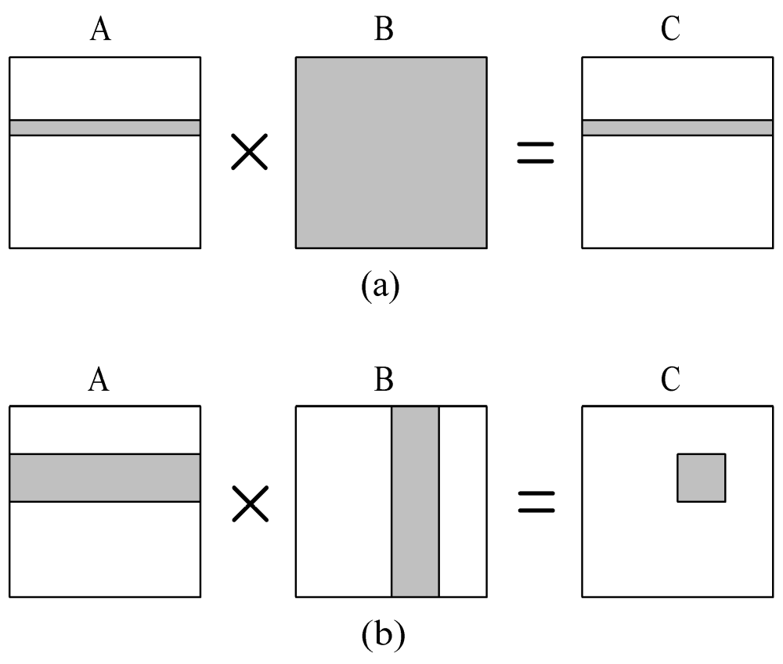
Elements of A and B Needed to Compute a Process’s Portion of C
Algorithm 1
Cannon’s
Algorithm

Slide 16
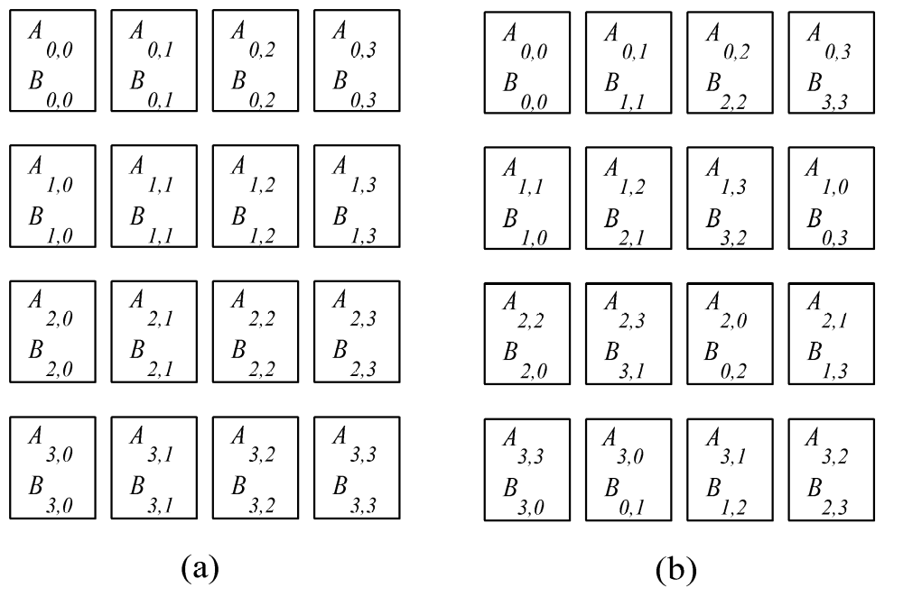
Blocks Must Be Aligned
Before
After

Slide 17
Blocks Need to Be Aligned
B00
B01
B02
B03
Each triangle
represents a
matrix block
Only same-color
triangles should
be multiplied
A00
A01
A02
A03
B10
B11
B12
B13
A10
A11
A12
A13
B20
B21
B22
B23
A20
A21
A22
A23
B30
B31
B32
B33
A30
A31
A32
A33

Slide 18
Rearrange Blocks
B00
B11
B22
B33
A00
A01
A02
A03
Block Aij cycles
left i positions
Block Bij cycles
up j positions
B10
B21
B32
B03
A11
A12
A13
A10
B20
B31
B02
B13
A22
A23
A20
A21
B30
B01
B12
B23
A33
A30
A31
A32

Slide 19
Consider Process P_{1,2}
B22
A11
A12
B32
Step 1
A13
A10
B02
B12

Slide 20
Consider Process P_{1,2}
B32
A12
A13
B02
Step 2
A10
A11
B12
B22

Slide 21
Consider Process P_{1,2}
B02
A13
A10
B12
Step 3
A11
A12
B22
B32

Slide 22
Consider Process P_{1,2}
B12
A10
A11
B22
Step 4
A12
A13
B32
B02

Slide 23
Complexity Analysis
Algorithm has √p iterations
During each iteration process multiplies two (n / √p ) × (n / √p ) matrices: Θ(n³ / p ^{3/2})
Computational complexity: Θ(n³ / p)
During each iteration process sends and receives two blocks of size (n / √p ) × (n / √p )
Communication complexity: Θ(n²/ √p)

Slide 24
This system is highly scalable!
Sequential algorithm: Θ(n³)
Parallel overhead: Θ(√pn²)

